Slide 1
FC20 Quick Start Training

Slide 2
Lifeloc Technologies, Inc.
Vision
  Lifeloc protects people, saves lives and makes the world a safer place by delivering superior products, services and value for our customers
Our vision drives us to:
Understand and anticipate the needs of our customers.
Sustain our industry leading customer service.
Protect, refine and leverage our technologies to deliver superior products.
Increase our knowledge and expertise to expand our future products and services.
Conduct business in an ethical, honest and straightforward manner.
Reward our investors and stakeholders through a thriving, profitable and growing business.
Notes:
6 lower bullets slide in

Slide 3
Alcohol Overview

Slide 4
Alcohol Basics
Types of Alcohol
Methanol
methyl alcohol, CH3OH, wood alcohol, carbinol
Ethanol
Ethyl alcohol, C2H5OH, grain alcohol (beer, wine, and liquor)
Isopropanol
C3H7OH, isopropyl alcohol, rubbing2-propanol, propyl alcohol, rubbing alcohol

Slide 5
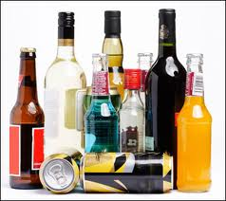
Alcohol Basics
Types of Alcohol
Ethanol
The type of alcohol we consume and is common in in products from perfume to mouthwash. Ethonal is a common compound that can be found in water, fruit juice, food products, garbage, etc. due to the fermentation process (yeast + water + sugar, or various other carbohydrates)
  Alcohol is foreign to the body and is a poison; the body works to quickly eliminate it from the system
  This makes it imperative to conduct and complete the testing process quickly
Notes:
Bread or baked goods can easily ferment. Story on prisons. Energy drinks and fruit juices

Slide 6
Alcohol Testing Technology
Lifeloc’s Products Utilize Fuel Cell Technology
Highly Accurate
Long Life
Unlimited Number of Tests
Easily Calibrated
Alcohol Specific
Screening & Evidential Testing
Widely Used form of Testing
  Reliable and Accurate
  Portable

Slide 7
Alcohol Testing Technolgies
Fuel Cells
Main components
Plastic housing (2)
Membrane w/2 electrodes
Contact leads

Slide 8
Alcohol Testing Technology
Fuel Cells
Fuel Cells generate electrical energy by oxidizing a fuel (alcohol) to generate a minute electrical current
The electrical current is measured and mathematically analyzed to determine how much alcohol is present in the breath sample
Fuel cells are alcohol specific, eliminating the possibility of invalid tests due to false positive results from some other substance

Slide 9
Alcohol Testing Technologies
Fuel Cells
gas inlet
(breath)
gas outlet
cover
electrode- oxidation
case
bottom
membrane
electrode- reduction
Schematic of the housing
The housing is made of two plastic parts - bottom and cover.
The two components are heat sealed on the top side.

Slide 10
Alcohol Testing Technologies
Fuel Cells
Fuel cells are highly durable and provide accurate results for years but there are precautions that should be taken to make certain that these devices perform for the longest period of time possible:
  Use the device: Fuel cells like moisture, so it is good idea to take tests periodically to provide needed moisture to the fuel cell
  Avoid cigarette smoke: Make sure no one is permitted to
  blow smoke into your device. Nicotine can destroy a fuel cell.
Notes:
Moisture is especially important in dry climates: you do not need alcohol, just breath.
Cigarette smoke can damage or destroy the fuel cell.

Slide 11
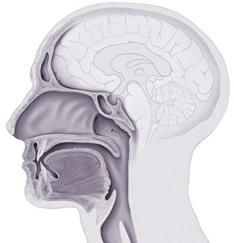
Alcohol Facts
Absorption
Begins in Immediately through Mucus Membranes
Continues in the Esophagus and Stomach
Fastest Absorption occurs in Small Intestine
Rate varies significantly w/outside influences
  Type of liquor
  Gender
  Body Weight
  Metabolism

Slide 12
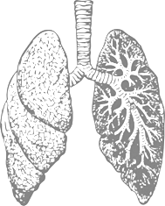
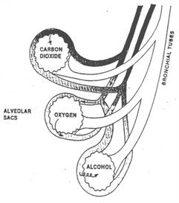
Alcohol Testing
Sample Accuracy
Proper Breath Sample
  Must measure alveolar or “deep lung” air
  With no residual mouth alcohol present
WHY
  The exchange of alcohol from breath to blood occurs in the alveoli of the lungs (deep lung region).
  If not deep lung, the result can be diluted by breath from the upper respiratory tract, or tainted by mouth alcohol

Slide 13
Alcohol Facts
Residual Mouth Alcohol
Products Containing Alcohol that may cause a “positive” result due to residual mouth alcohol
  Mouthwash
  Breath Spray
  Cough Syrup
15 Minute Wait Period Before Testing Recommended
  Allows certain types of alcohol to dissipate from the subject’s breath
  Results will then indicate only alcohol in bloodstream
  Allows for more accurate testing

Slide 14
FC Overview
Testing Modes
Testing Modes
  Automatic
    Unit automatically takes sample while subject is blowing into mouthpiece
      Automatic override: operator manually triggers test while subject is blowing into mouthpiece
  Manual
    Operator manually triggers test while subject is blowing into mouthpiece
  Passive
    No mouthpiece is used
    Subject blows toward port on unit and operator manually triggers sample
    Results shown as POS or NEG, no numerical value is displayed

Slide 15
FC Overview

Slide 16
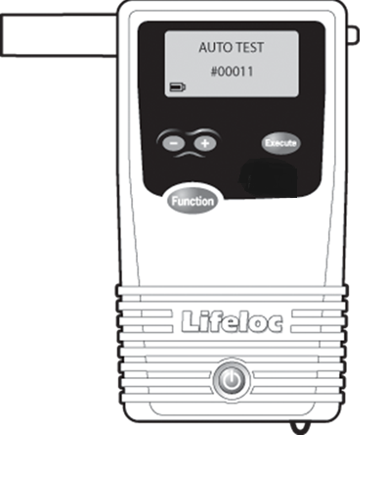
Product Overview
Getting Started
Large Graphic LCD Screen
Mouthpiece
Mouthpiece Ejector Tab
Battery Icon
+/- Buttons for data entry or setting standards
Execute Button enables you to perform functions
Function Button scrolls through menus and saves changes (acts as the Save key)
Power Button turns unit on and off; also returns you to main testing mode (acts as a
Home key)
Wrist Strap Attachment Loop

Slide 17
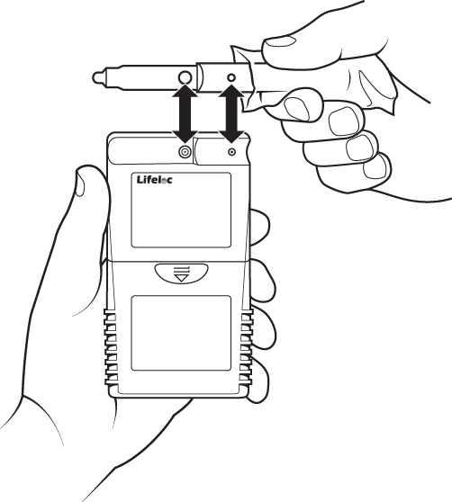
Product Overview
Attaching a Mouthpiece
Attach a fresh mouthpiece before each direct test
Remove the mouthpiece from its wrapper, making sure not to touch the end which the subject will be blowing into.
Attach the mouthpiece to the port on the back of the FC.
Line up the mouthpiece port over the holes in the back of the mouthpiece. Press in place.
Ensure it is securely attached.
To remove a mouthpiece, use the tab
attached to the end that is away from
The device.

Slide 18
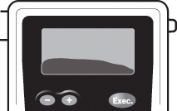
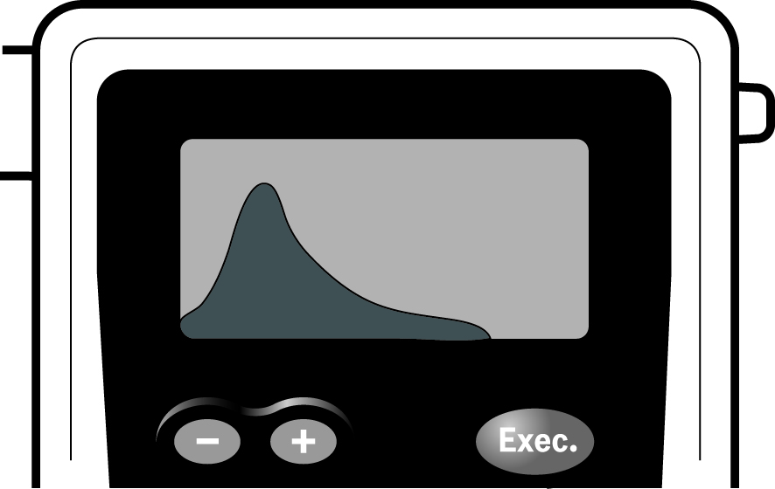
Product Overview
Visual Cues
Breath Flow Graph
  As the subject blows into the mouthpiece, the FC will show a graph of the breath flow on the display, as well as showing the amount of liters. Liters are shown in the upper left corner.
Alcohol Curve
  If the FC detects alcohol, the alcohol level is graphed and will be displayed before the result.

Slide 19
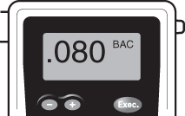
Product Overview
Visual Cues
Test Results
  After the alcohol is graphed, the test result is displayed.
  The results are displayed as a 3-digit BAC number for direct test.
  The result will remain on the screen until the Function or Power button is pressed.
  The FC10 holds the last test in memory
  The FC10Plus holds 100 tests in memory
To View Previous Result(s)
  Press the Function button until the printer icon is displayed.
  The results of the last test will be displayed along with its test number at the lower left of the display.
  Press the + or - button to scroll between test results.
  Momentarily press the Power button to return to the testing mode.

Slide 20
Product Overview
The FC Series requires 4 AA Batteries which can be standard or NiMH Rechargeable
The FC Series has 2 trigger modes
  End of Breath
  Precise Volume, which triggers after 1.5 liters of breath (*this is the factory default and can be changed in the settings)
Internal operating temperature is 0- 55°C
The FC Series has an adjustable backlight LCD display; this is set at 5 but can be adjusted through the settings menu
*The Settings menu can be found by repeatedly pressing the Function button

Slide 21
Product Overview
The FC20 holds 4000 tests in memory
The FC20 has multiple data entry fields
The FC20 has printing capability and is compatible with AlcoMark Software
The FC20 has a time and date stamp
  It will compensate for leap years but not daylight savings or time zones

Slide 22
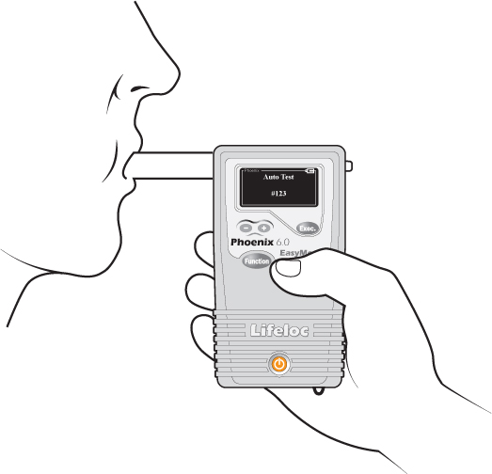
Alcohol Testing
Direct Testing: AutoTestMode
1. Press the Power button to start the unit.
2. Unit will run a self diagnostic check.
3. Verify the display reads “AUTOTEST”.
4. Attach a new mouthpiece to the back of the unit.
5. Have the subject blow steadily into the mouthpiece for about 4 seconds (listen for the beeping audio prompts to guide you). Do not have the subject blow as hard as they can.
6. Read the result.
For subjects with limited lung capacity, you can manually override a test by pressing the Execute button to take a sample. This is discussed in the next slide.
Always position the subject so they are blowing away from you

Slide 23
Alcohol Testing
Direct Testing: Manual Override of an AutoTest
1. Press the Power button to start the unit.
2. Unit will run a self diagnostic check.
3. Verify the display reads “AUTOTEST”.
4. Attach a new mouthpiece to the back of the unit.
5. Have the subject blow steadily into the mouthpiece and while the subject is still blowing, press and release the Execute button. The breath graph can help act as a guide as to when press the Execute button.
6. Read the result.

Slide 24
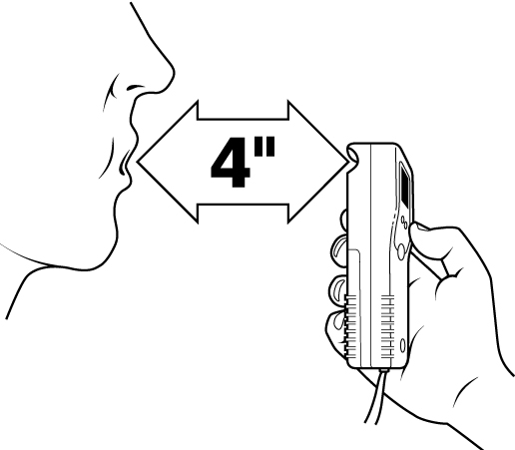
Alcohol Testing
Passive Subject Testing:
1. Press the Power button to start the unit.
2. Unit will run a self diagnostic check.
3. Verify the display reads “PASSIVE TEST” this is accomplished by pressing the Function button until displayed.
4. Position the subject so they can blow directly towards the orange port on the back of the device.
5. From approximately 4” away instruct the subject to towards the port, while the subject is blowing press and release the Execute button.
6. Read the result, which will either read NEG or POS as this testing does not display a numerical value.

Slide 25
User Prompts

Slide 26
User Prompts
Defined
Prompt | Explanation
<1.3L Retest or Try Manual Test | Breath flow ended before the subject blew the minimum liters of breath. Instruct subject to try again or use manual test mode.
>6.0 | BAC is unusually high and above 0.6 BAC. Subject may require medical attention.
Air Blank Failed (optional and must be purchased) | Alcohol was detected during an air blank. Move to another location and retry.
Calibration/Cal Check Expired (optional setting) | Calibrate or Cal Check the unit.
Calibration/Cal Check Expiring (optional setting) | The unit is within 48 hours of the Calibration or Cal Check lockout time.
External Interference | External interference has been detected. Move to a different location and try again. If error persists, call Lifeloc Technical Support.
Notes:
Clean up in chart form adding FST codes … don’t use all

Slide 27
User Prompts
Defined
Prompt | Explanation
Flow Error - Retry & Blow Steadily | Exhalation not complete or interrupted. Instruct subject to blow steadily as long as they can.
Invalid Calibration/Cal Check | No alcohol was detected. Repeat setup, then retest.
Low Battery | Battery voltage is too low to take a test. Replace batteries.
Low Li Battery | The internal clock battery is low. Contact Lifeloc Technical Support.
Pump Reset Needed | The pump needs to be reset. Follow onscreen instructions.
Temperature | When calibrating or taking a test, unit is outside of temperature limits. Calibration range = 68o - 95o F (20o - 35o C) Testing range = 32o - 130o F (0o - 55o C)
Timeout | User blew for > 15 seconds. Try again, blow harder.

